Slide 1
Restaurant Application GitHub Portfolio Project Presentation
Insoo Kim

Slide 2
Part 2: Database And API

Slide 3
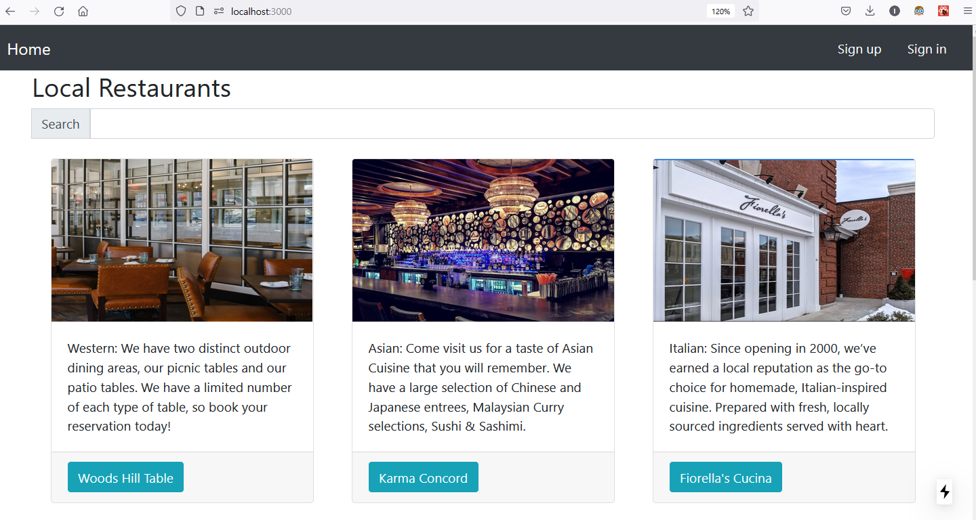
Database 1 – List restaurants

Slide 4
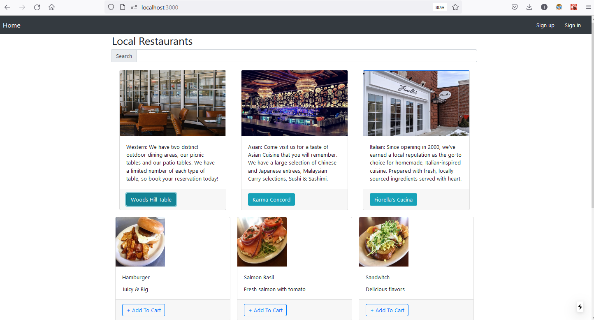
Database 2 – List dishes when selecting a restaurant
Selected

Slide 5
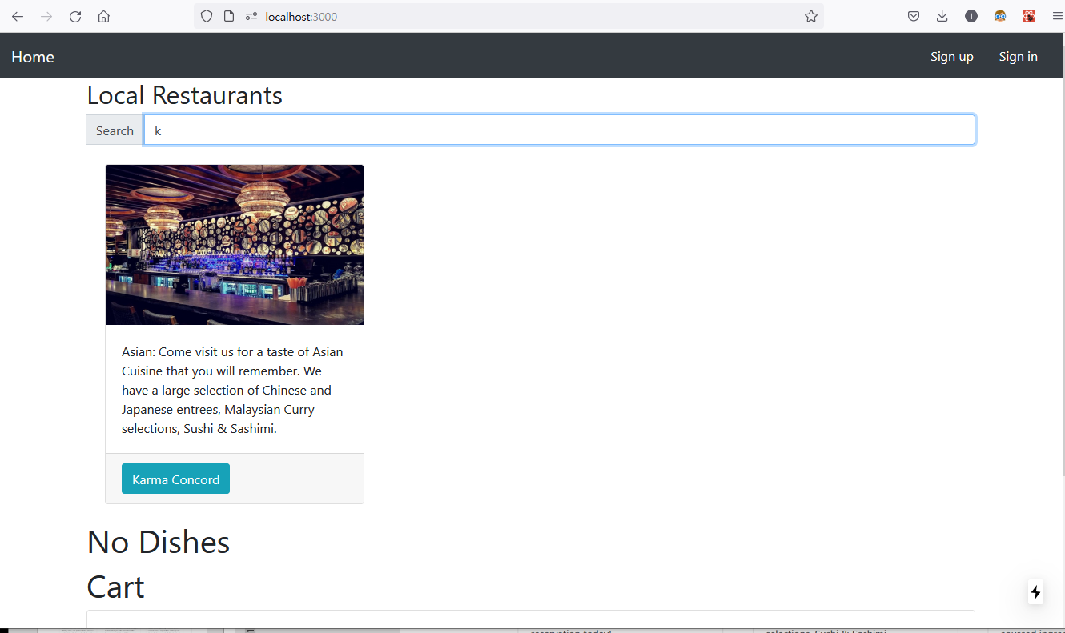
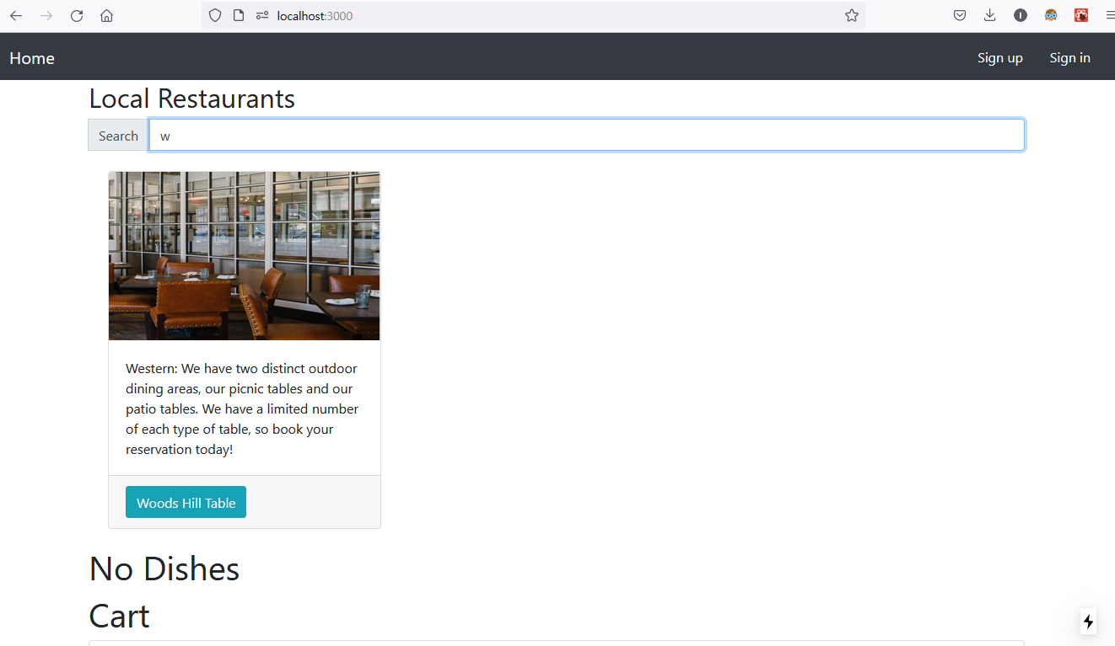
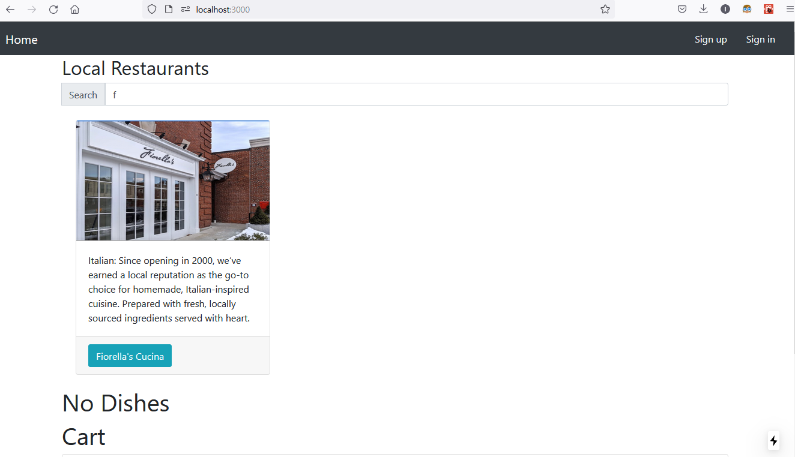
Database 3 – Search restaurants from home page
Homepage
Search word

Slide 6
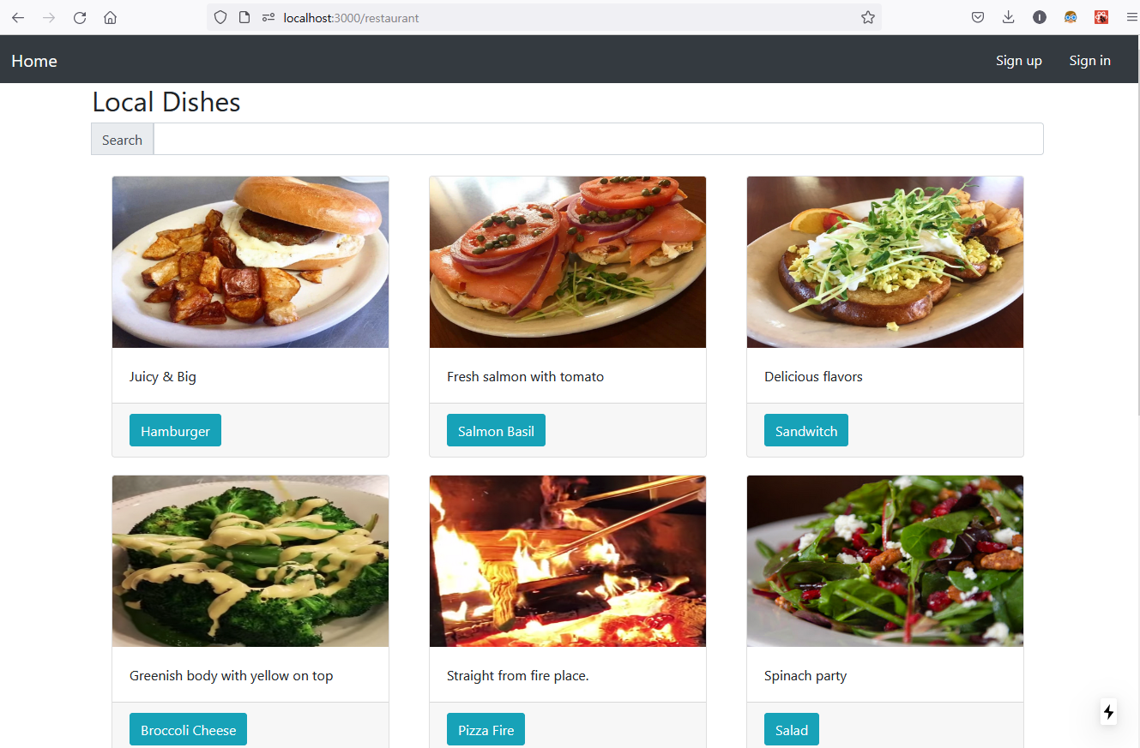
Database 4 – Search dishes from restaurant page (1/2)
Search word empty

Slide 7
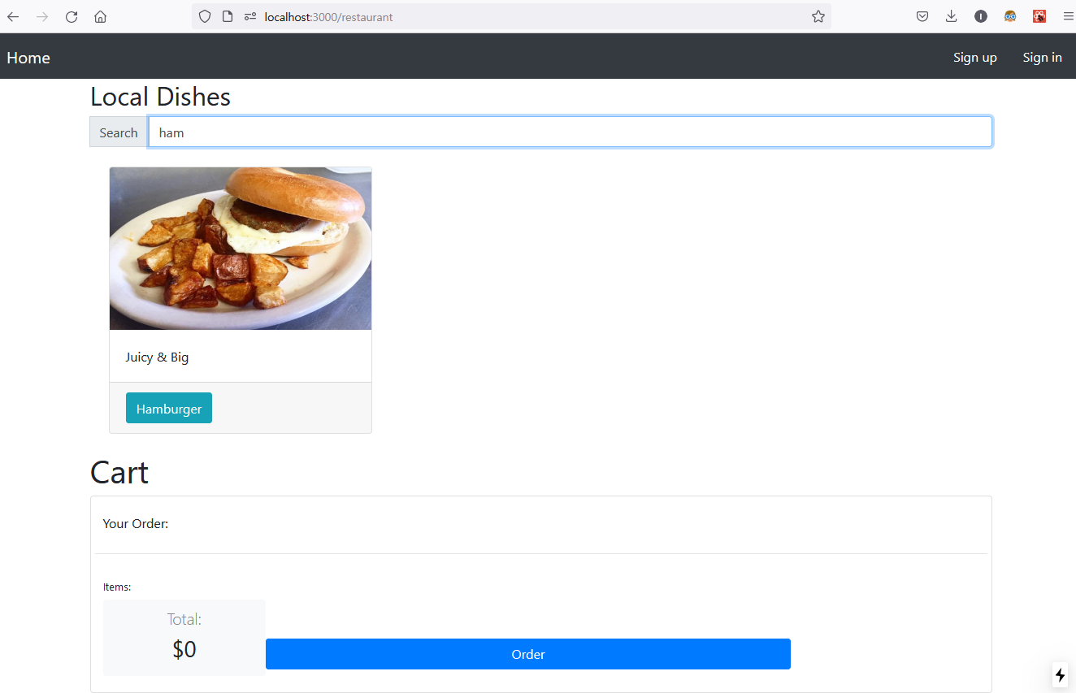
Database 5 – Search dishes from restaurant page (2/2)
restaurant page
Search word: ham

Slide 8
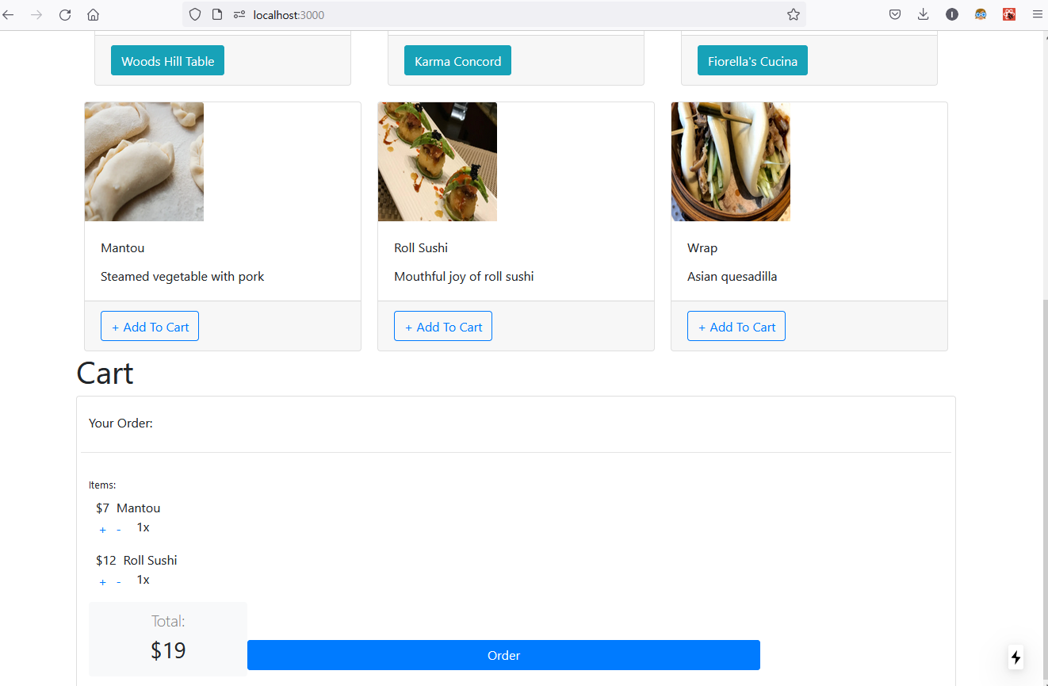
Database 6 – Cart: Add dishes
Added dishes

Slide 9
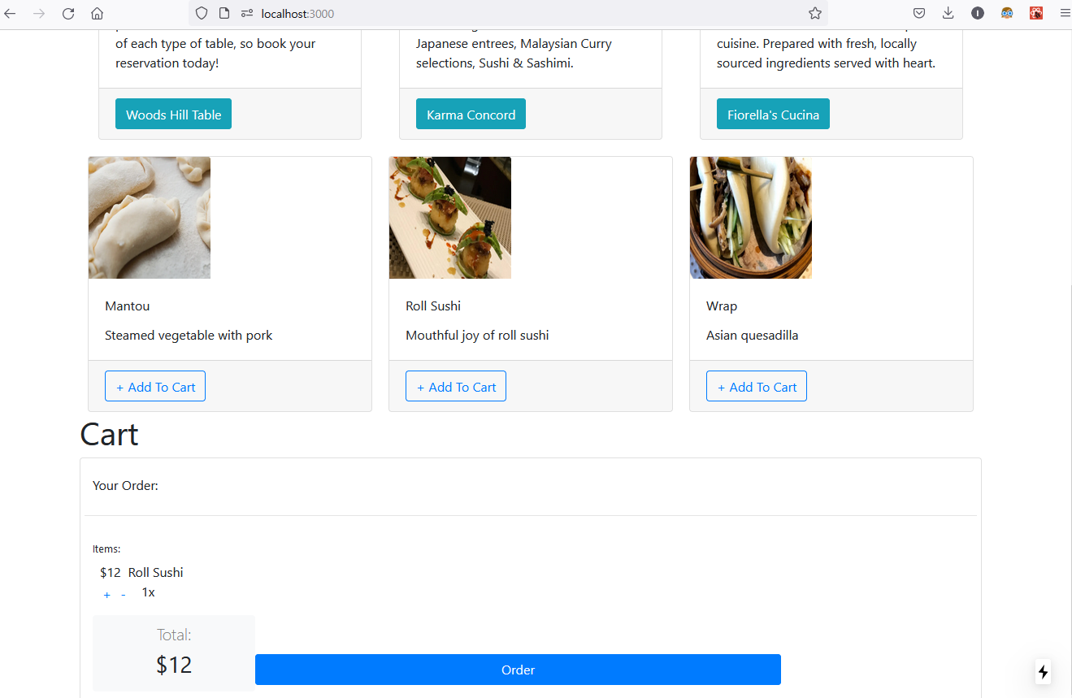
Database 7 – Cart: Remove dishes & Automatic price update
“Mantou” is removed by clicking (-) from the previous cart screen.
Price is updated automatically

Slide 10

Database 8 – Cart: Quantity update
Order quantity is updated by clicking (+) from the previous cart screen.
Clicking (-) will make it decrease.
Price is updated as intended

Slide 11
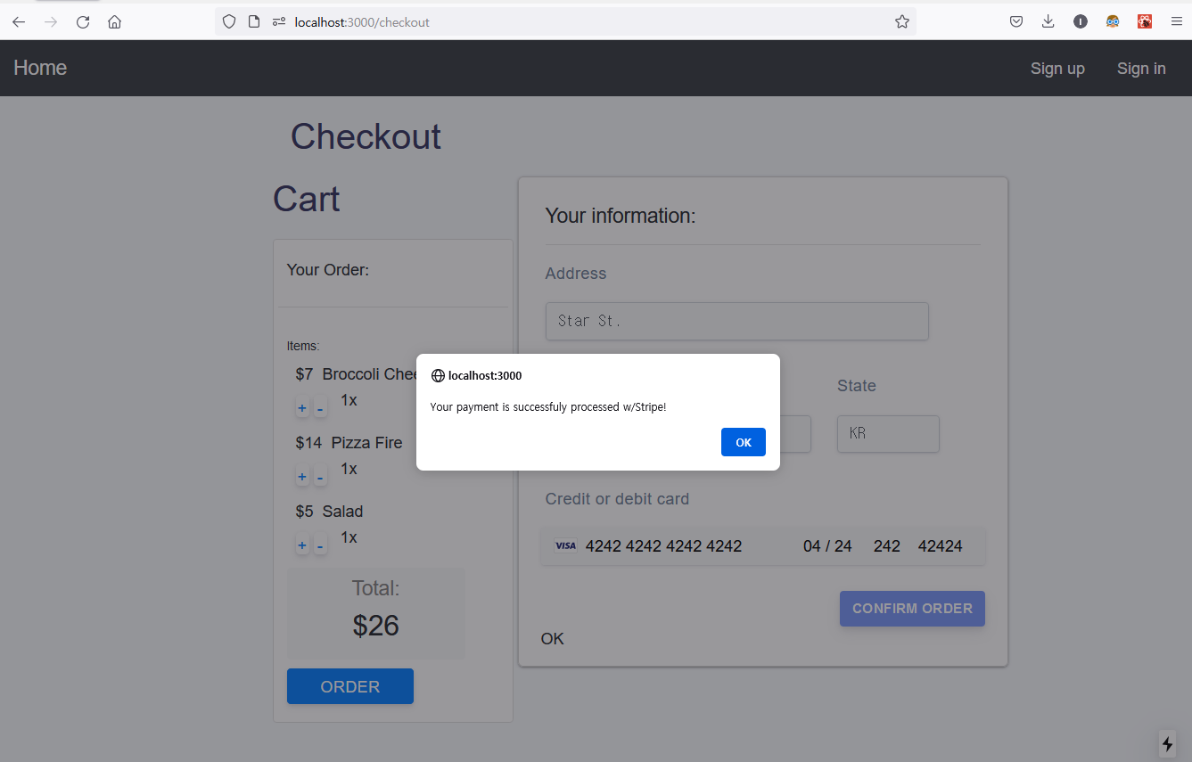
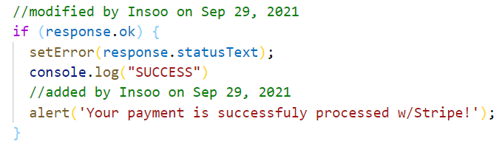
Database 9 – Checkout success message
In /components/checkoutForm.js,
the check condition for the response of payment operation is updated like the screenshot below.

Slide 12
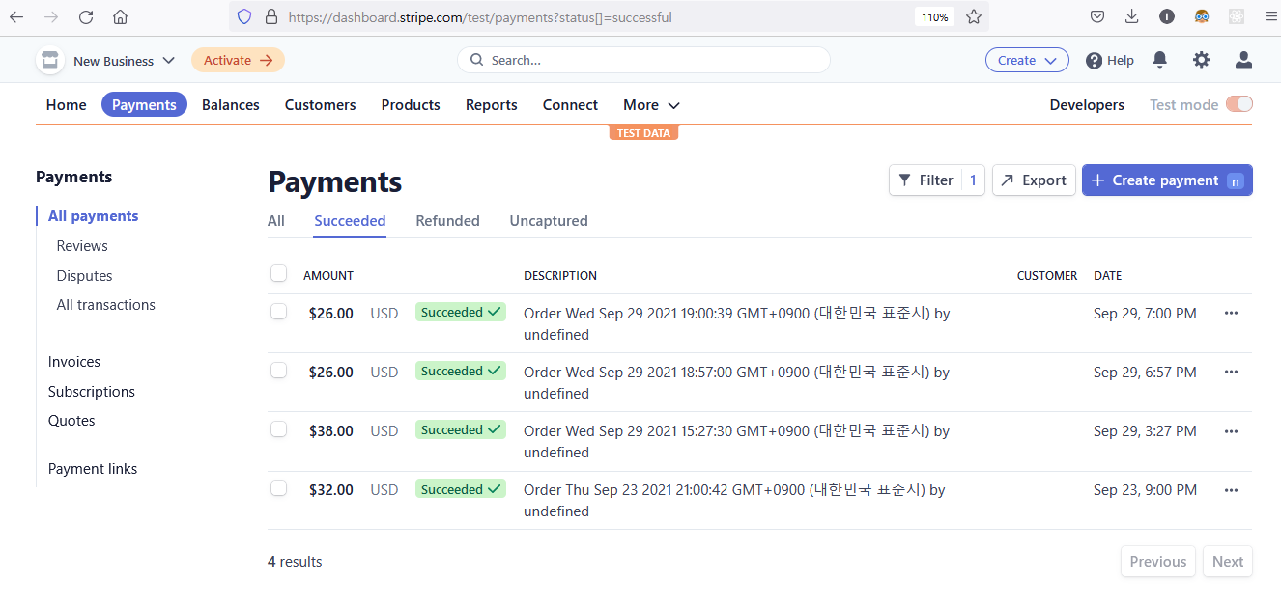
Database 10 – Checkout w/Stripe
Success!

Slide 13
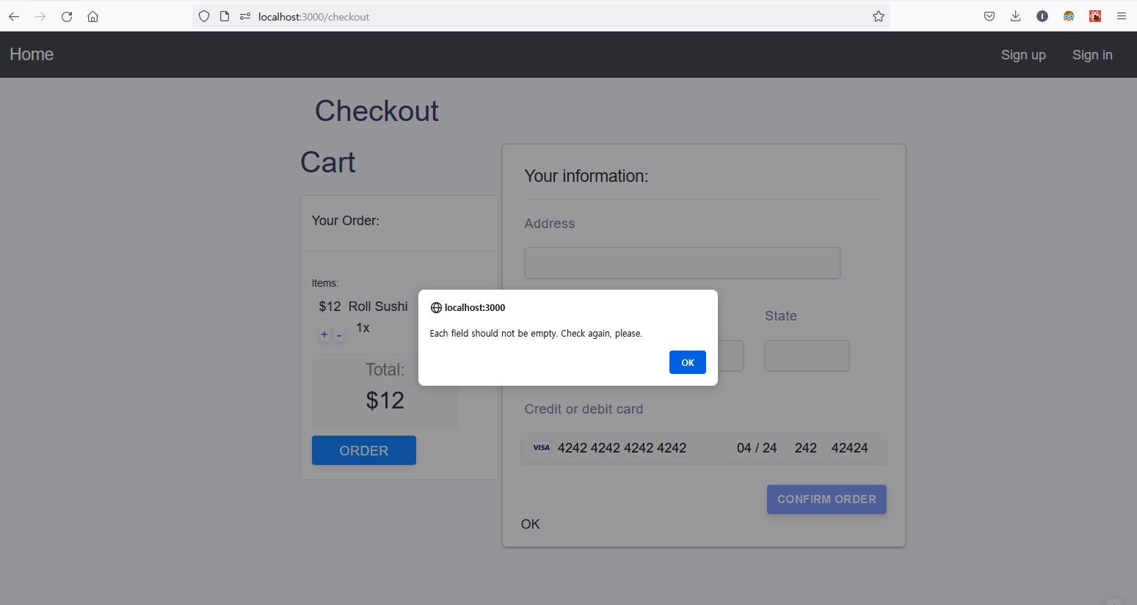
Database 11 – Checkout input validation

Slide 14
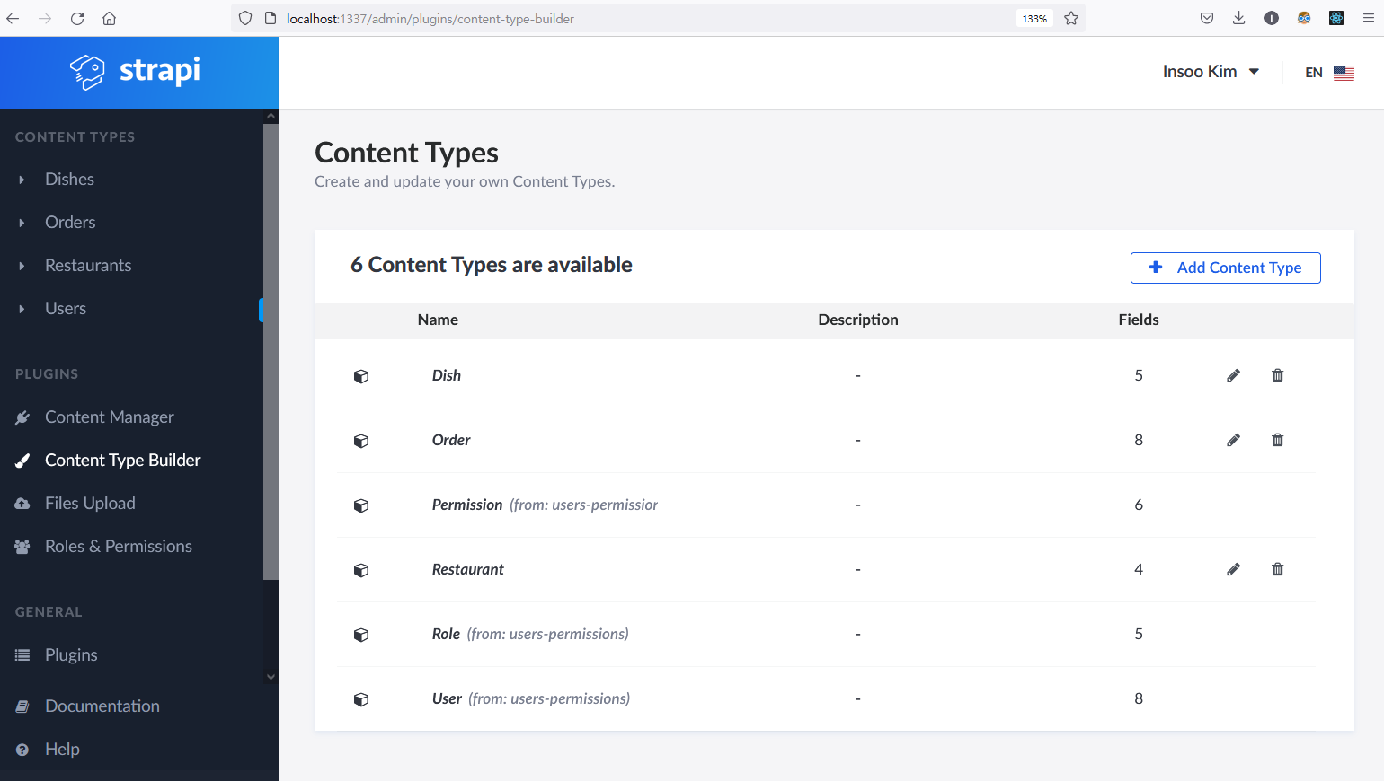
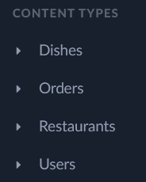
Database 12 – Description (1/3): Data persistence & types
Data storage & types
In Strapi, you can use Content Type Builder to store your app data.
I’ve used the database for Dishes, Orders, Restaurants and Users .

Slide 15
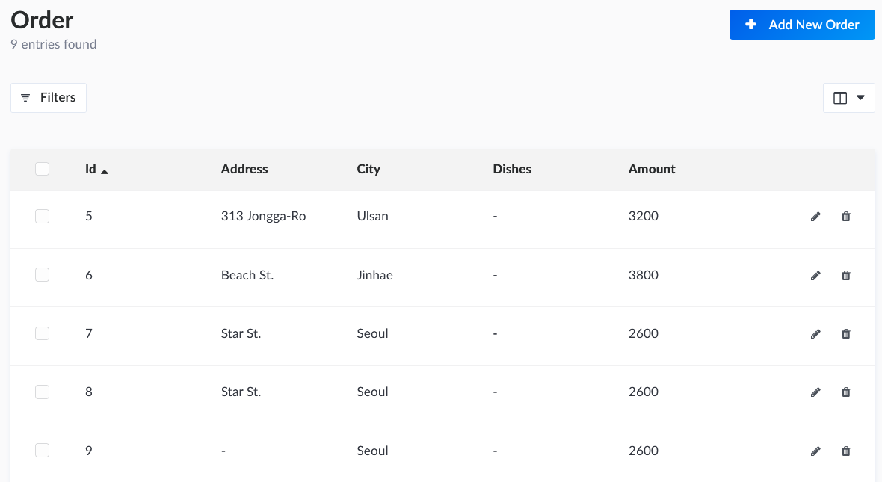
Database 13 – Description (2/3): New features
Input validation for preventing empty string at DB fields
In /components/checkoutForm.js, the input validation code for Address, City and State is added like the screenshot below.
This eventually prevents empty address info. stored at the Order database
Empty address is stored before implementing validation!

Slide 16
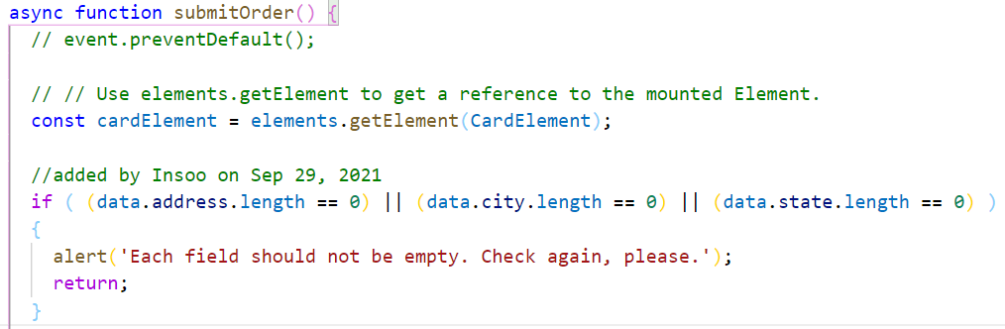
Database 14 – Description (3/3): Challenges & Overcome
props v. State
When implementing input validation in /components/checkoutForm.js, I’d taken {data} as props, so my routine was not working properly.
Looking the code printed on paper, I’ve noticed that it is declared as State. And, solved my issue by not passing {data} to function submitOrder as props, but using it as already-declared State.

Slide 17
API 1 – API protocol & endpoints
GraphQL or RESTful: I’ve used GraphQL API
API endpoints
“/”: Home page for Search & List restaurants and Order dishes
“restautants: Search dishes
“/register”: Sign up a new user whose account is managed by Strapi or Firebase
“/login”: Sign in a user whose account is managed by Strapi, Google or Firebase

Slide 18
API 2 – Documentation showcase
Using Swagger, we can do API documentation efficiently.

